Slide 1
Predicting Survey Submissions with Machine Learning
Lou Zhang
Brandon Croarkin

Slide 2
About the Problem
Monthly survey on manufacturing order and shipment data
Reliant on participants to submit
Generates important info for participants such as market size, market growth, and their position relative to competition
We need to predict who is not going to submit so we can encourage non-submitters to participate

Slide 3
Importance of Problem
Participation vital to survey success
Non-participation leads to chain reaction unraveling of survey, which may lead to eventually no survey at all
Predicting too many non-participants is not as big of an issue as missing non-participants
Balance cost of overclassifying (too much manpower dedicated to reaching out) to cost of underclassifying (losing the survey and key product of the client)

Slide 4

Goal
Goal
Achieve 90% recall on non-participants
Our “net” should capture 90% of all non-participants
The 90% of non submitters...
Not capturing a few (10%) is OK..

Slide 5
Goal
Goal
Ignore recall and precision on participants and precision on non-participants
No action on submitters and mis-predicting a few non-submitters is ok
Capturing and contacting a few submitters in our net is ok

Slide 6
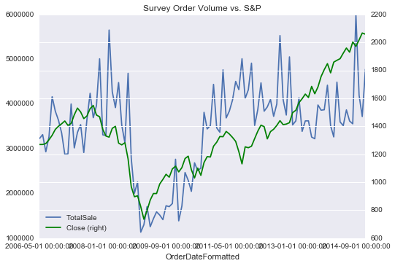
EDA Discoveries
S&P 500 and Industrial Production are two external key features that may be predictive of survey order volume - data released prior to survey period

Slide 7
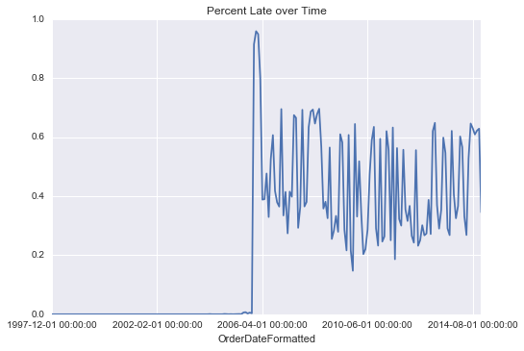
EDA Discoveries
Data from prior to April 2006 needed to be excluded - inconsistencies in reporting structure led to different ways of tracking late submitters

Slide 8
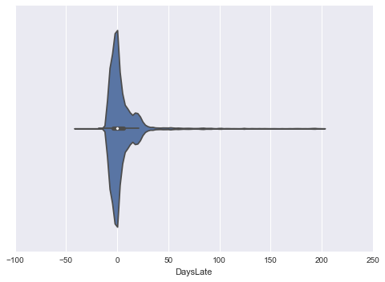
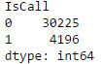
EDA Discoveries
Vast majority of participants submit on time or nearly on time - non-submission is not rampant
Historically 85% do not need to have personal contact to submit - influenced the models we chose to be best for skewed classes (IsCall means we have to call them – 0 for don’t have to call, 1 for have to call)

Slide 9
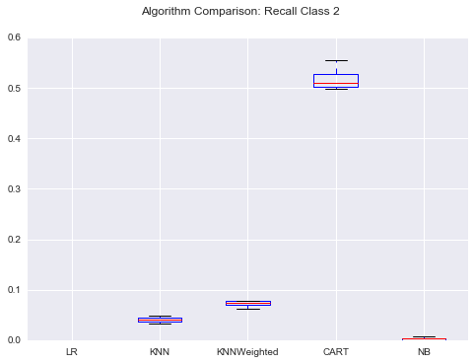
Approach and Results
Implemented ML models most relevant to business case
Tried several models at first - CART was clear early winner
But, goal of 90% recall on Class 2 was not reached, so tuning was required

Slide 10
Key Model: CART
CART (Decision Trees)
Good for visualizing problem
But subject to overfitting
Alleviation with max depth of 10 and minimum leaf size of 4000 samples
Ultimately did not achieve goal
Recall of 0.72

Slide 11
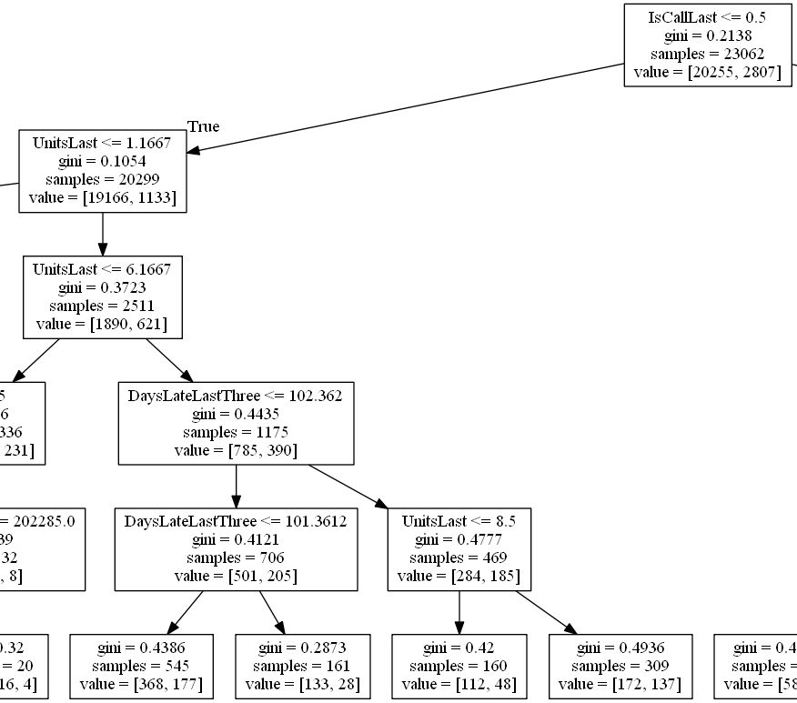
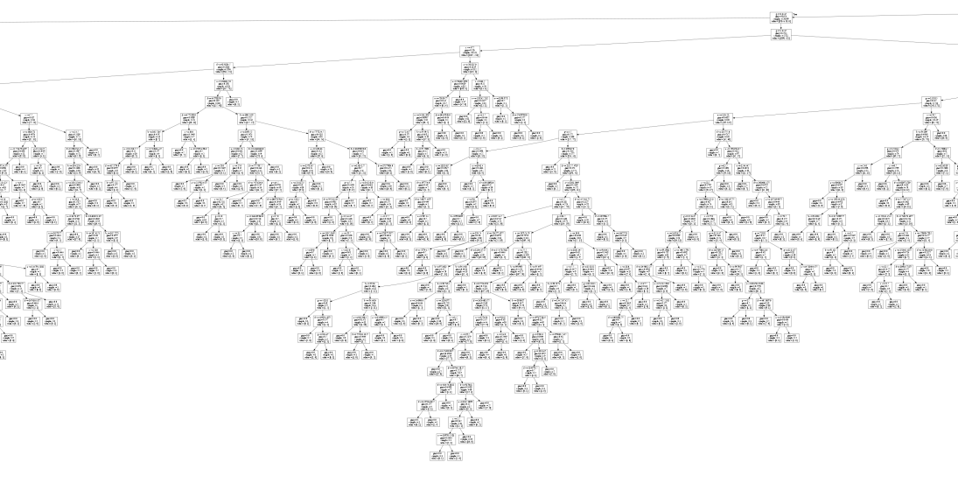
Remedies to increase recall
Add max depth to decision tree
Max Depth of 9
0.51 recall >> 0.53 recall (3.9% lift)

Slide 12
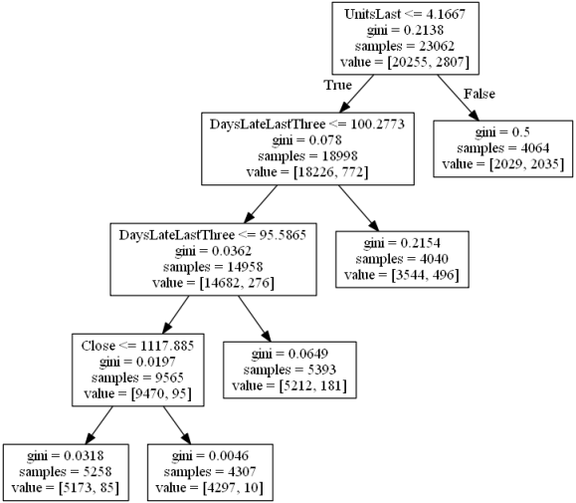
Remedies to increase recall
Add minimum samples for a leaf
Min samples per leaf of 4000
0.53 recall >> 0.72 recall (36% lift)

Slide 13
Remedies to increase recall (failed)
Restrict to a maximum number of leaf nodes
Restricting Max Leaf Nodes, to any level, did not increase recall
Random splits on nodes instead of best split
Random splitting (not based on Gini) did not increase recall
Splits based on information gain (entropy) instead of Gini impurity
Splitting on entropy did not increase recall

Slide 14
Insights
Data set makes it difficult to reach our goal of 90% recall on non-participants
Difficulty in “bucketing” participants and non-participants given our selected features
Revealed by how many leaves our decision tree had, and how small the buckets were had relative to the amount of data
There are over 200 leaves in just this picture!

Slide 15
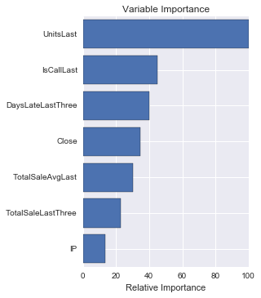
Insights
Most influential variables
Units sold may be good predictor because it reveals participants’ business conditions - more likely to take the time to submit when business is good
Chronic late submitters (being called last time and being late for the last three periods) may have a structural issue
S&P close correlation to order submission volume slightly predictive

Slide 16
Further Analysis
Incorporate new data sets from hoster
Weblogs, user behavior in submission website
Apply new features to classification model
Look into other algorithms to maximize recall for Class 2
Random Forest: reduces variance of decision trees: tune max depth, minimum number of samples per leaf
SVMs: less prone to overfitting, our major problem with decision trees: tune intercept scaling, weights for classes

Slide 17
Application to Business Problem
Even without further analysis, we can begin testing the model on new data points as they come in
Verify recall of model after 6-month testing phase
Model is not ready to go into a fully automated system that can reach out to problem participants, but we can still take the findings of the model to improve the efficiency of our participant outreach
By using the classifications of participants created by the models, we can focus our attention on the delinquent participants (random sample of 20/mo)

